Slide 1
CSE 320: Memory
Chapter 6
Professor Dan Benz

Slide 2
Memory Hierarchies
Some fundamental and enduring properties of hardware and software:
  Fast storage technologies cost more per byte, have less capacity, and require more power (heat!).
  The gap between CPU and main memory speed is widening.
  Well-written programs tend to exhibit good locality.
These fundamental properties complement each other beautifully.
They suggest an approach for organizing memory and storage systems known as a memory hierarchy.

Slide 3
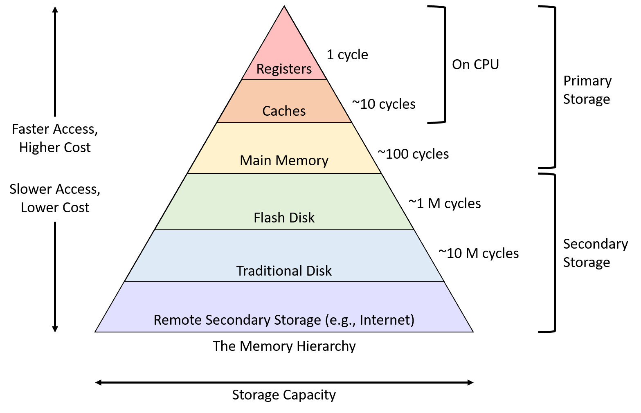
The Memory Hierarchy:

Slide 4
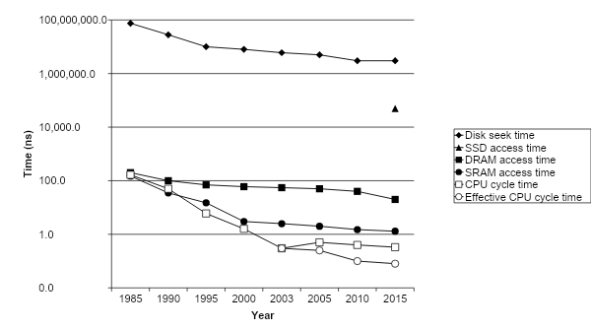
The CPU-Memory Gap
The gap widens between DRAM, disk, and CPU speeds.
Disk
SSD
DRAM
CPU

Slide 5
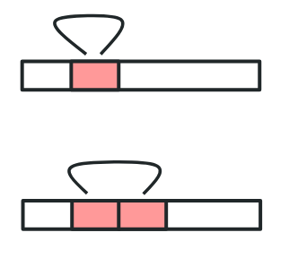
Locality
Principle of Locality: Programs tend to use data and instructions with addresses near or equal to those they have used recently
Temporal locality:
  Recently referenced items are likely
  to be referenced again in the near future
Spatial locality:
  Items with nearby addresses tend
  to be referenced close together in time

Slide 6
Locality Example (1D):
sum = 0;
for (i = 0; i < n; i++)
sum += a[i];
return sum;
Data references
  Reference array elements in succession (stride-1 reference pattern).
  Reference variable sum each iteration.
Instruction references
  Reference instructions in sequence.
  Cycle through loop repeatedly.
Spatial locality
Temporal locality
Spatial locality
Temporal locality

Slide 7
Qualitative Estimates of Locality
Claim: Being able to look at code and get a qualitative sense of its locality is a key skill for a professional programmer.
Question: Does this function have good locality with respect to array a?
int sum_array_rows(int a[M][N])
{
int i, j, sum = 0;
for (i = 0; i < M; i++)
for (j = 0; j < N; j++)
sum += a[i][j];
return sum;
}

Slide 8
Locality Example (3D):
Question: Can you permute the loops so that the function scans the 3-d array a with a stride-1 reference pattern (and thus has good spatial locality)?
int sum_array_3d(int a[M][N][N])
{
int i, j, k, sum = 0;
for (i = 0; i < N; i++)
for (j = 0; j < N; j++)
for (k = 0; k < M; k++)
sum += a[k][i][j];
return sum;
}

Slide 9
Hardware:
How does memory actually work
  RAM (Random Access Memory, “main memory”)
  SSDs (solid state drives, a middle ground between disk and RAM)
  HDDs (Hard disk drives, “Disk”)
  Other memory devices
We can then use this knowledge to write better code
  Or at least understand OS design decisions

Slide 10
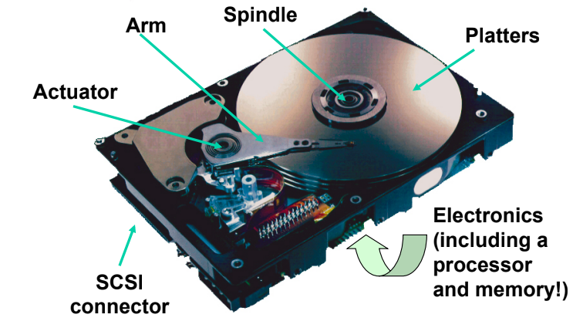
What’s Inside A Disk Drive?

Slide 11
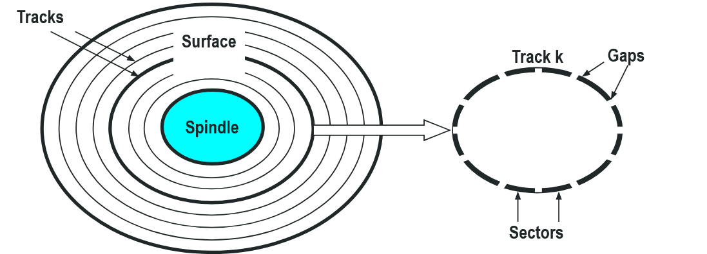
Disk Geometry
Disks consist of platters, each with two surfaces.
Each surface consists of concentric rings called tracks.
Each track consists of sectors separated by gaps.

Slide 12
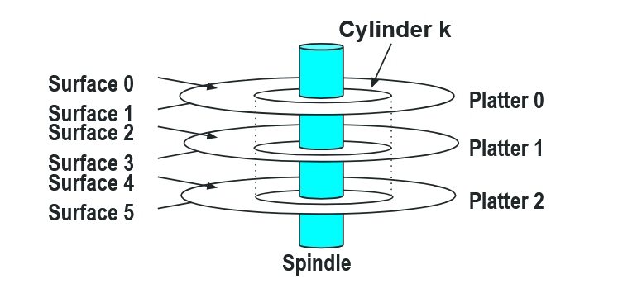
Disk Geometry (Muliple-Platter View)
Aligned tracks form a cylinder.

Slide 13
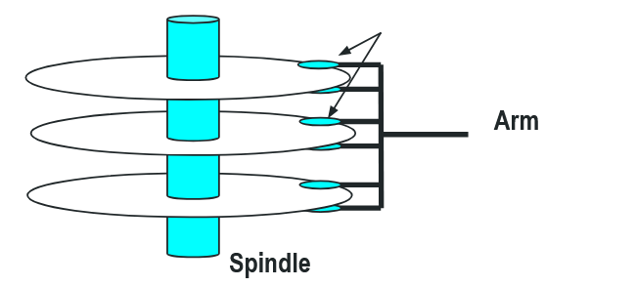
Disk Operation (Multi-Platter View)
Read/write heads
move in unison
from cylinder to cylinder

Slide 14
Computing Disk Capacity
Capacity: maximum number of bits that can be stored
  Vendors express capacity in units of gigabytes (GB), where 1 GB = 10⁹ Bytes.
Capacity = (# bytes/sector) x (avg. # sectors/track) x (#tracks/surface) x (# surfaces/platter) x (# platters/disk)
Example:
  512 bytes/sector
  300 sectors/track (on average)
  20,000 tracks/surface
  2 surfaces/platter
  5 platters/disk
Capacity = 512 x 300 x 20000 x 2 x 5 = 30,720,000,000 = 30.72 GB

Slide 15
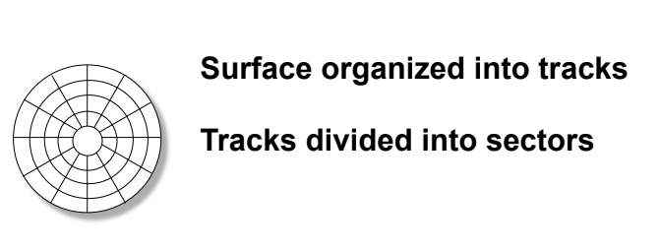
Disk Structure - top view of single platter
Notes:
Goal:
Show the inefficeincy of current disk requests.
Conveyed Ideas:
Rotational latency is wasted time that can be used to service tasks
Background Information:
None.
Slide Background:
None.
Kill text and arrows

Slide 16
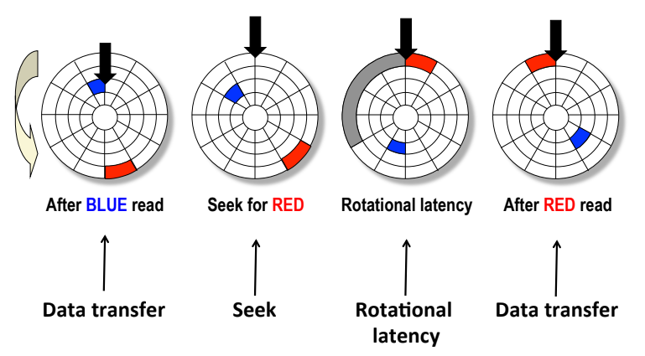
Disk Access
Notes:
Goal:
Show the inefficeincy of current disk requests.
Conveyed Ideas:
Rotational latency is wasted time that can be used to service tasks
Background Information:
None.
Slide Background:
None.
Kill text and arrows

Slide 17
Disk Access Time
Average time to access some target sector approximated by :
  Taccess = Tavg seek + Tavg rotation + Tavg transfer
Seek time (Tavg seek)
  Time to position heads over cylinder containing target sector.
  Typical Tavg seek is 3—9 ms
Rotational latency (Tavg rotation)
  Time waiting for first bit of target sector to pass under r/w head.
  Tavg rotation = 1/2 x 1/RPMs x 60 sec/1 min
  Typical Tavg rotation = 7200 RPMs
Transfer time (Tavg transfer)
  Time to read the bits in the target sector.
  Tavg transfer = 1/RPM x 1/(avg # sectors/track) x 60 secs/1 min.

Slide 18
Disk Access Time Example
Given:
  Rotational rate = 7,200 RPM
  Average seek time = 9 ms.
  Avg # sectors/track = 400.
Derived:
  Tavg rotation = 1/2 x (60 secs/7200 RPM) x 1000 ms/sec = 4 ms.
  Tavg transfer = 60/7200 RPM x 1/400 secs/track x 1000 ms/sec = 0.02 ms
  Taccess = 9 ms + 4 ms + 0.02 ms
Important points:
  Access time dominated by seek time and rotational latency.
  First bit in a sector is the most expensive, the rest are free.
  SRAM access time is about 4 ns/doubleword, DRAM about 60 ns
    Disk is about 40,000 times slower than SRAM,
    2,500 times slower then DRAM.

Slide 19
Logical Disk Blocks
Modern disks present a simpler abstract view of the complex sector geometry:
  The set of available sectors is modeled as a sequence of b-sized logical blocks (0, 1, 2, ...)
Mapping between logical blocks and actual (physical) sectors
  Maintained by hardware/firmware device called disk controller.
  Converts requests for logical blocks into (surface,track,sector) triples.
Allows controller to set aside spare cylinders for each zone.
  Accounts for the difference in “formatted capacity” and “maximum capacity”.

Slide 20
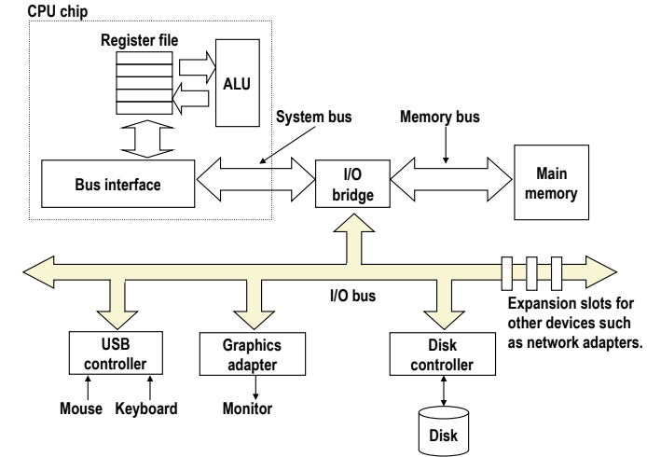
I/O Bus

Slide 21
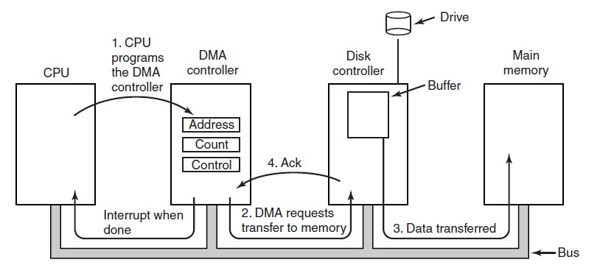
DMAs:
To move large amounts of data from Memory to Disk (or vice versa)
  Don’t want to make CPU “babysit” the transfer.

Slide 22
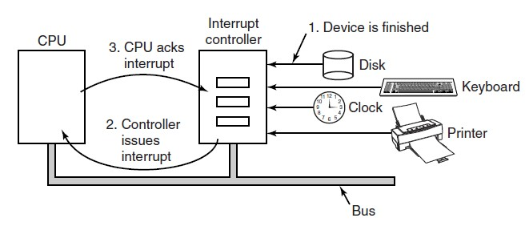
Interrupts:
In general the CPU is the bus “controller”
  Every bus transaction is initiated by the CPU
What about when we want to tell the CPU something has happened?
  Could make the CPU check a mailbox periodically (polling)
  What if we add a way to tell the CPU that “You’ve got Mail”?
  This is what an Interrupt controller does
    CPU still needs to read the message and decide next steps

Slide 23
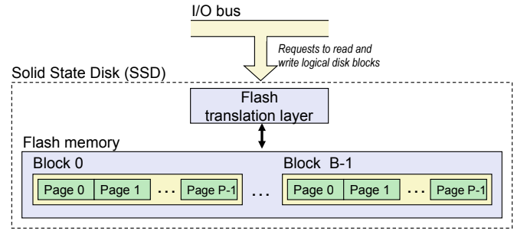
Solid State Disks (SSDs)
Pages: 512KB to 4KB, Blocks: 32 to 128 pages
Data read/written in units of pages.
Page can be written only after its block has been erased
A block wears out after about 100,000 repeated writes.

Slide 24
SSD Performance Characteristics
Sequential read tput 550 MB/s Sequential write tput 470 MB/s
Random read tput 365 MB/s Random write tput 303 MB/s
Avg seq read time 50 us Avg seq write time 60 us
Sequential access faster than random access
  Common theme in the memory hierarchy
Random writes are somewhat slower
  Erasing a block takes a long time (~1 ms)
  Modifying a block page requires all other pages to be copied to new block
  In earlier SSDs, the read/write gap was much larger.
Source: Intel SSD 730 product specification.

Slide 25
SSD Tradeoffs vs Rotating Disks
Advantages
  No moving parts 🡪 faster, less power, more rugged
Disadvantages
  Have the potential to wear out
    Mitigated by “wear leveling logic” in flash translation layer
    E.g. Intel SSD 730 guarantees 128 petabyte (128 x 10¹⁵ bytes) of writes before they wear out
  In 2015, about 30 times more expensive per byte
Applications
  MP3 players, smart phones, laptops
  Middle ground between RAM and HDDs in desktops and servers

Slide 26
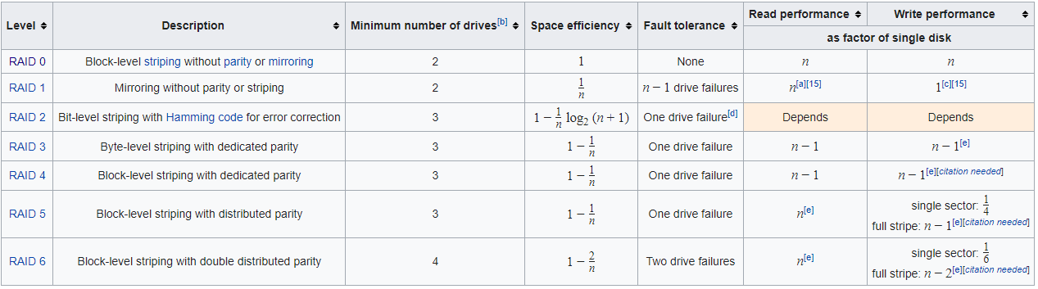
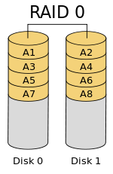

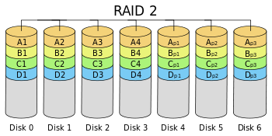
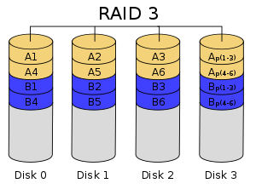
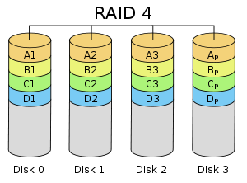
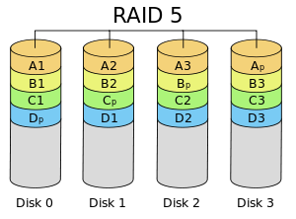
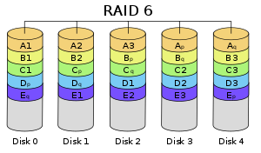
RAID:

Slide 27
Volatile Memory mediums:
The most common types of volatile memory are the Flip-Flop, the Static RAM, and the Dynamic RAM. These three types of memory are used to construct registers, caches, and DDR chips respectively.

Slide 28
Non-volatile Memory mediums:
Hard Disks have a thin film of magnetic material on each side to store data.
Optical disks (CDs) instead use the ability of the medium to reflect light (normally a laser) to encode data.
Flash memory uses (floating gate) MOSFETs to store state electrically. They are either structured as NOR or NAND.

Slide 29
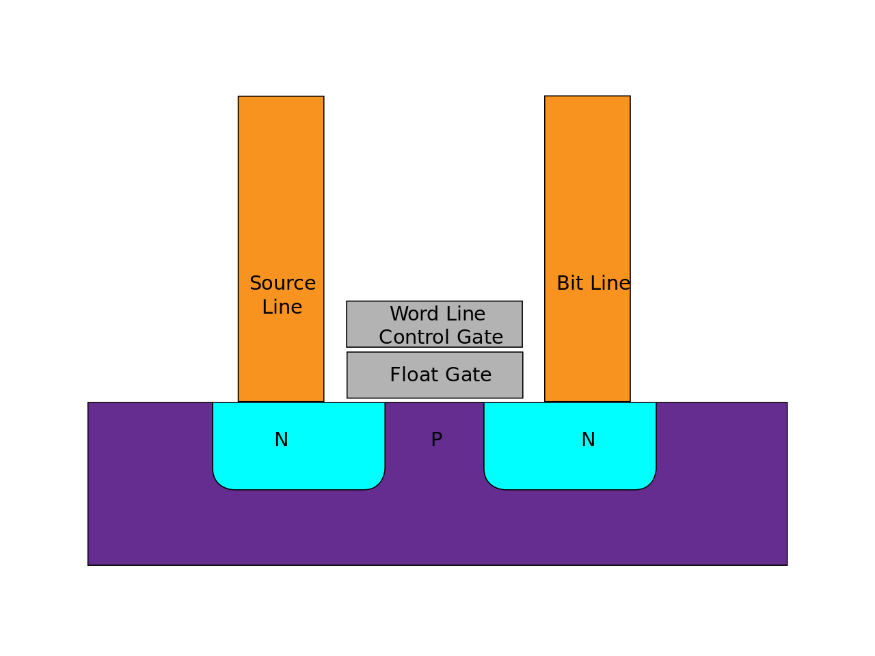
Flash memory:
Flash memory stores electrical charge in the Floating Gate of a MOSFET transistor. This means that storage can be embedded directly into the die of a semiconductor.
Flash memory is characterized either as NAND or NOR. Flash memory only has a limited number of erase and program cycles before the transformers begin to degrade after ~100k writes (denser flash chips may only support up to ~1k writes).

Slide 30
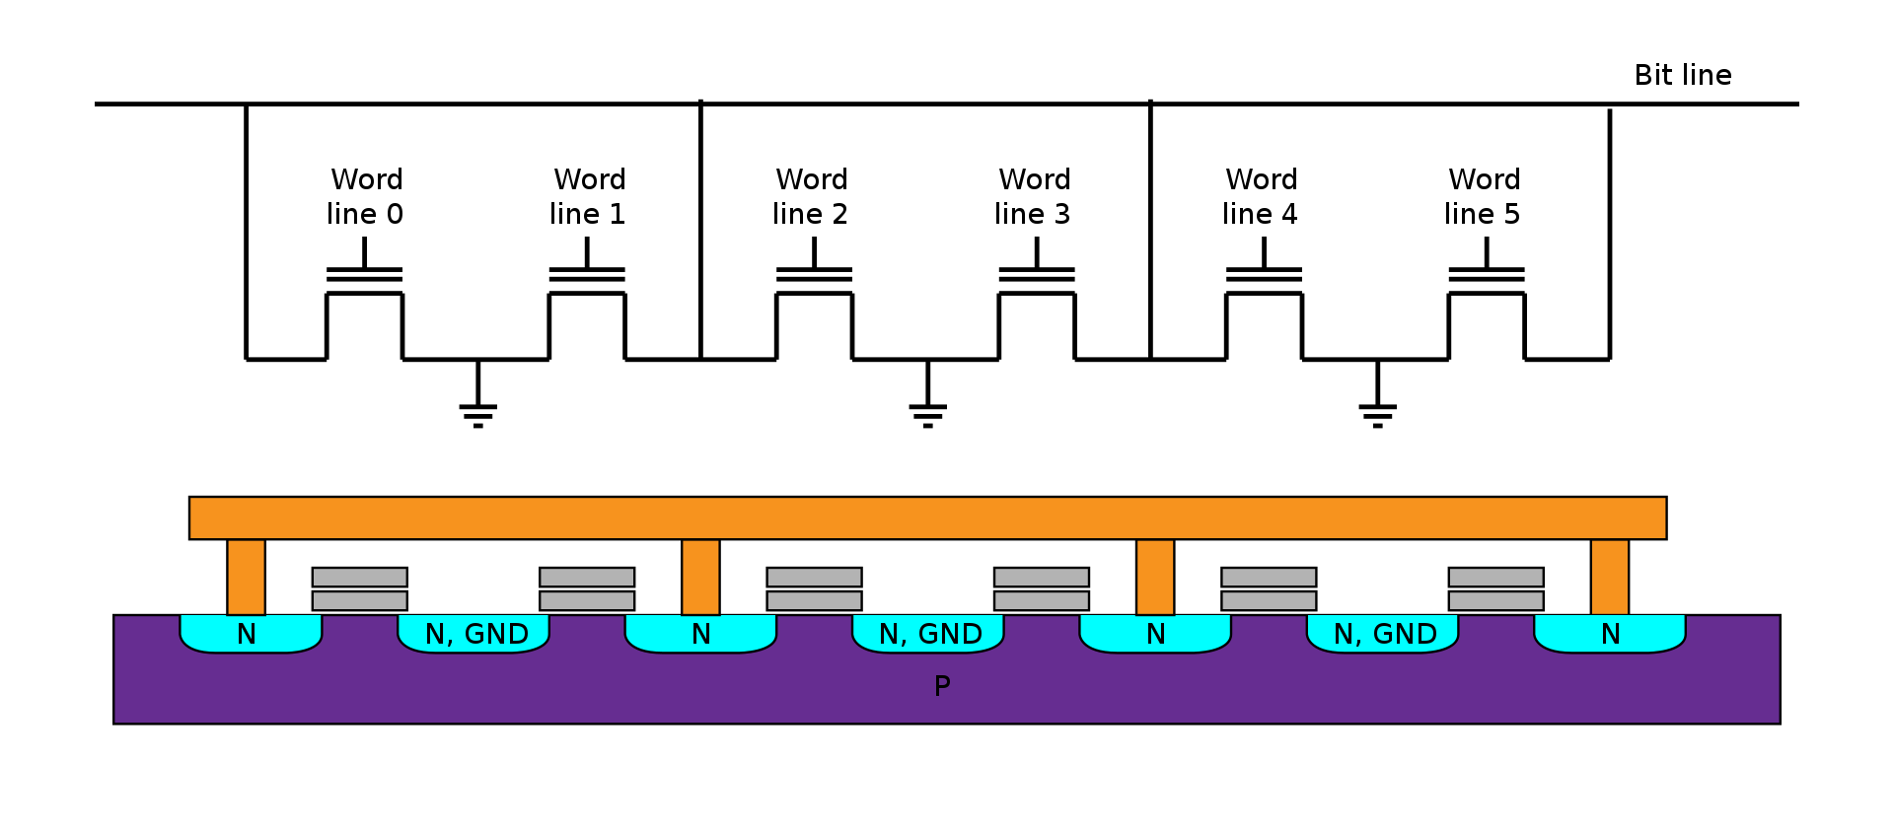
NOR Flash:
NOR flash has a lower read latency since each word line can be accessed independently but it has much lower memory density.

Slide 31
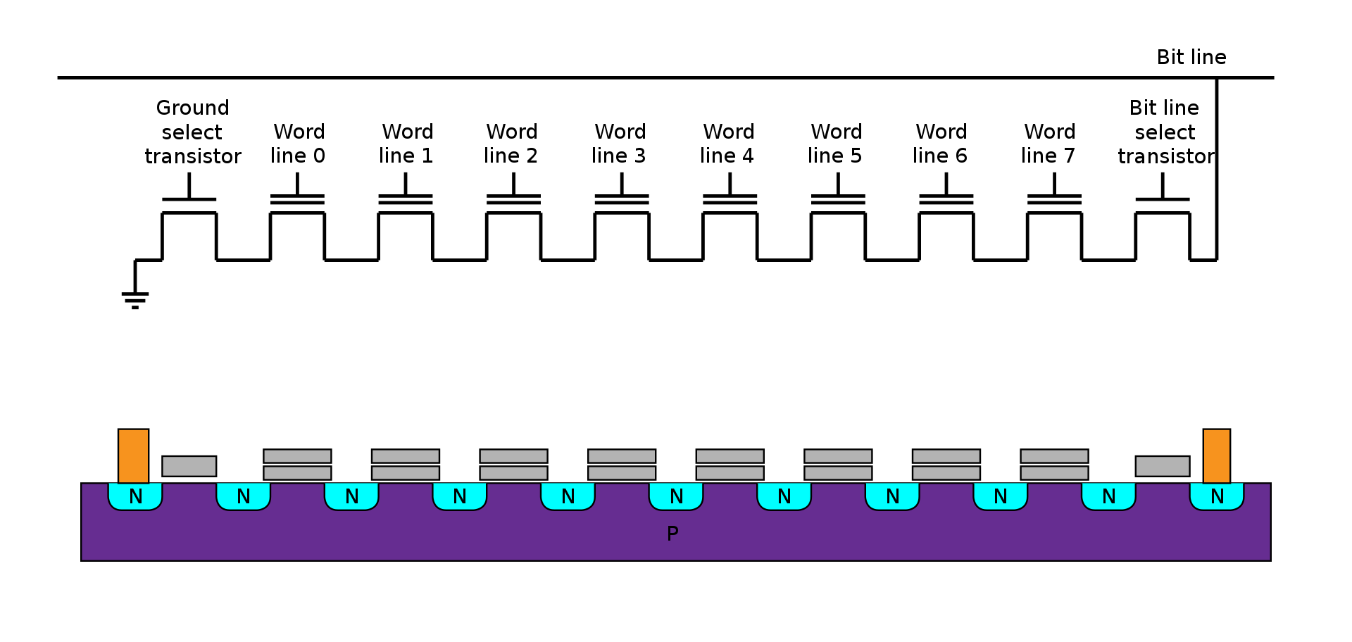
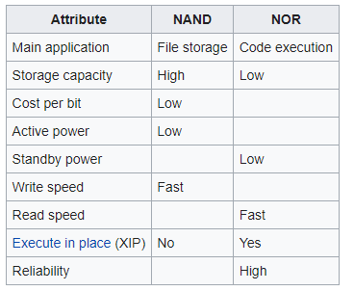
NAND:
NAND flash is significantly more dense than NOR flash and can be written faster but it takes longer to read NAND flash. SSDs are normally built using NAND flash.

Slide 32
Common Memory Interfaces:
(These are all generalities, there might be one-off chips that use a different memory type)
DDR (RAM) : DRAM
Cache & registers : SRAM
I2C/SPI (EEPROM) & QSPIs : NOR
SATA/NVMe (SSD) & USB/SD/eMMC : NAND

Slide 33
Memory Interfaces explained (1):
DDR: Large parallel system. One data pin for each bit and up to 11 address pins that are each used to specify a Row and Columns of memory. The name comes from the fact that the bus drives on both rising and falling edges of clocks.

Slide 34
Memory Interfaces explained (2):
I2C: 2 wire (clock & data) open drain bidirectional interface with 9 cycle frames including an acknowledge as the 9th cycle. (100-400kHz)
SPI: 4 wire (clock, chip select, 2x data [MISO and MOSI]) interface. (25MHz - 108MHz)
QSPI: SPI but with 4 bidirectional data lines instead of MISO/MOSI.
SD/eMMC use an interface similar to SPI.

Slide 35
Memory Interfaces explained (3):
SATA: four wire (1 differential pair in each direction) interface designed to access SSDs. (1.5+GHz)
NVMe: extension of PCIe (4 diff pairs in each direction) to access SSDs (2.5+GHz)
USB: 4 (2.0) or 8 (3.0) wire interface (usb 2.0 has a data diff pair, 5V, and GND, USB 3.0 adds two PCIe speed diff pairs [Tx & Rx]) (480MHz - 5 GHz)

Slide 36
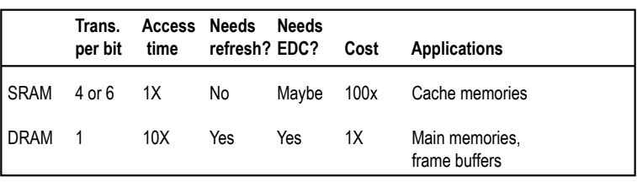
Random-Access Memory (RAM)
RAM comes in two varieties:
  SRAM (Static RAM)
  DRAM (Dynamic RAM)
DRAM and SRAM are volatile memories
  Lose information if powered off.

Slide 37
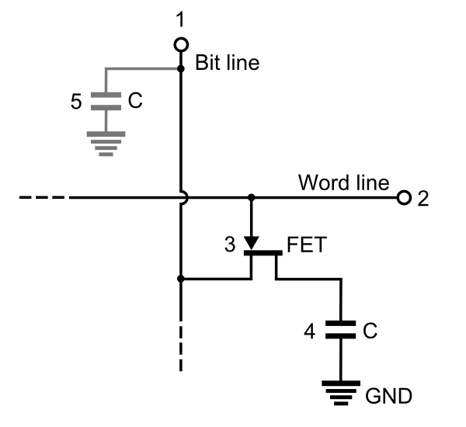
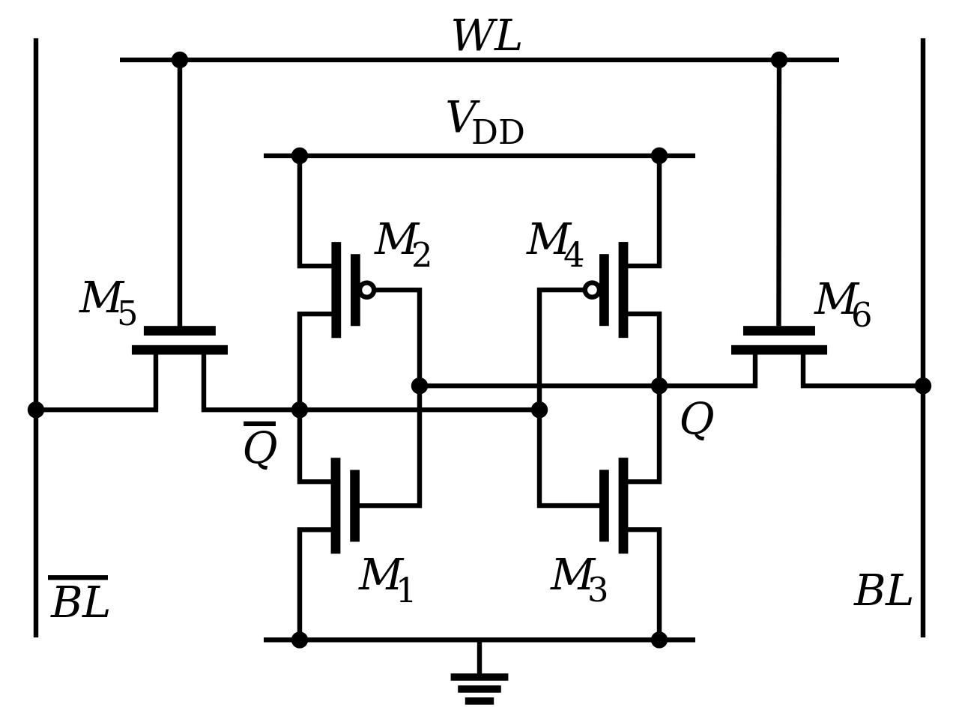
Static and Dynamic RAM:
DRAM (below) is constructed out of 1 FET and 1 Cap. This makes it very dense but the values must be constantly refreshed. This density is why it is used in DDR.
SRAM (below) is constructed out of 6 FETs. This makes it larger than DRAM but it retains value for as long as VDD is applied. This is what the caches and many registers of a CPU are made of.

Slide 38
Caches
Cache: A smaller, faster storage device that acts as a staging area for a subset of the data in a larger, slower device.
Fundamental idea of a memory hierarchy:
  For each k, the faster, smaller device at level k serves as a cache for the larger, slower device at level k+1.
Why do memory hierarchies work?
  Because of locality, programs tend to access the data at level k more often than they access the data at level k+1.
  Thus, the storage at level k+1 can be slower, and thus larger and cheaper per bit.
Big Idea: The memory hierarchy creates a large pool of storage that costs as much as the cheap storage near the bottom, but that serves data to programs at the rate of the fast storage near the top.

Slide 39
General Cache Concepts
Smaller, faster, more expensive
memory caches a subset of
the blocks
Cache
8
4
9
14
10
3
Data is copied in block-sized transfer units
4
10
Larger, slower, cheaper memory
viewed as partitioned into “blocks”
Memory
0
1
2
3
4
4
5
6
7
8
9
10
10
11
12
13
14
15

Slide 40
General Cache Concepts:
Hits
Misses
Placement policy:
  determines where new block goes
Replacement policy:
  determines which block gets evicted (victim)
Cache
8
9
14
3
14
Memory
0
1
2
3
4
5
6
7
8
9
10
11
12
13
14
15

Slide 41
General Caching Concepts: Types of Cache Misses
Cold (compulsory) miss
  Cold misses occur because the cache is empty.
Conflict miss
  Most caches limit blocks at level k+1 to a small subset (sometimes a singleton) of the block positions at level k.
    E.g. Block i at level k+1 must be placed in block (i mod 4) at level k.
  Conflict misses occur when the level k cache is large enough, but multiple data objects all map to the same level k block.
    E.g. Referencing blocks 0, 8, 0, 8, 0, 8, ... would miss every time.
Capacity miss
  Occurs when the set of active cache blocks (working set) is larger than the cache.

Slide 42
Examples of Caching in the Mem. Hierarchy
Cache Type
What is Cached?
Where is it Cached?
Latency (cycles)
Managed By
Registers
4-8 bytes words
CPU core
0
Compiler
TLB
Address translations
On-Chip TLB
0
Hardware MMU
L1 cache
64-byte blocks
On-Chip L1
4
Hardware
L2 cache
64-byte blocks
On-Chip L2
10
Hardware
Virtual Memory
4-KB pages
Main memory
100
Hardware + OS
Buffer cache
Parts of files
Main memory
100
OS
Disk cache
Disk sectors
Disk controller
100,000
Disk firmware
Network buffer cache
Parts of files
Local disk
10,000,000
NFS client
Browser cache
Web pages
Local disk
10,000,000
Web browser
Web cache
Web pages
Remote server disks
1,000,000,000
Web proxy server

Slide 43
Summary
The speed gap between CPU, memory and mass storage continues to widen.
Well-written programs exhibit a property called locality.
Memory hierarchies based on caching close the gap by exploiting locality.

